Slide 1
Real-time IoT Traffic Monitoring on Azure
Team Members:
Priyeshwar
Pooja Shree M
Swathi Baskaran

Slide 2
Table of Contents
Problem Statement
Project Overview
Prerequisites
Tools & Technology
Execution Overview
Implementation-Tasks
Practical Implementation on Azure Portal
Successful Output Generated
Optimization Strategies
Conclusion
Future enhancements

Slide 3
Problem statement
Challenge: Urban traffic generates massive volumes of high-velocity IoT sensor data (vehicle ID, speed, timestamps) that are difficult to ingest, process, and analyze in real time using traditional systems.
Need: A scalable real-time pipeline is required to ingest data via Azure Event Hub, process with Databricks (Spark Structured Streaming), and store in Delta Lake (Bronze/Silver/Gold) to deliver actionable insights such as average vehicle speed and traffic density for dashboards and alerts.

Slide 4
Project overview
Ingestion – Azure Event Hub Acts as the real-time entry point for telemetry data from multiple IoT producers (vehicles, sensors). Provides high-throughput and low-latency event capture.
Processing – Databricks Structured Streaming (PySpark) Cleanses, transforms, and aggregates streaming data in near real time. Ensures schema enforcement, watermarking, and fault tolerance.
Storage – Delta Lake on ADLS Gen2 (Bronze/Silver/Gold) Multi-layer storage for reliability and analytics:
Bronze: Raw ingested data
Silver: Cleaned and structured data
Gold: Aggregated insights (e.g., average speed, traffic density)
Consumption – Databricks SQL Curated Gold data is exposed for visualization, dashboards, and alerts to support real-time decision-making.

Slide 5
Prerequisites
Active Azure subscription and Event Hubs Namespace
Azure Databricks workspace & running cluster
ADLS Gen2 Storage account mounted to Databricks (Bronze/Silver/Gold folders)
Python & PySpark knowledge
Installed libraries & dependencies in Databricks

Slide 6
Tools & Technology
Azure Event Hub (ingestion)
Azure Databricks (Transformations & aggregations)
Delta Lake on ADLS Gen2 (storage for Bronze, Silver, Gold layers)
Python / PySpark
Databricks SQL (visualization)
Azure Monitor & Log Analytics (observability)

Slide 7
Execution Overview
Simulate IoT Data Python producer continuously generates random vehicle telemetry (vehicle_id, speed, timestamp) and sends it to Azure Event Hub.
Bronze Layer – Raw Ingestion Event Hub messages ingested into Delta Lake (Bronze) via Databricks Structured Streaming. Data is stored as-is with minimal transformation.
Silver Layer – Data Cleaning Apply schema enforcement, parse timestamps, and remove/handle malformed records. Store structured and cleaned data in Silver tables.
Gold Layer – Aggregated Insights Use windowing and watermarking to compute average vehicle speed and traffic density in 5-minute intervals. Store results in Gold Delta tables.
Analytics & Visualization Query Gold tables using Databricks SQL for analysis and visualization

Slide 8
Implementation tasks
Event Hub Setup → Scalable message broker enabling high-throughput ingestion from multiple IoT sources.
Data Simulation → Synthetic vehicle telemetry stream ensures controlled, testable, and repeatable data flows.
Streaming Pipeline → Continuous ingestion and transformation with checkpointing for fault tolerance and exactly-once semantics.
Delta Lake Layers → Multi-tier (Bronze/Silver/Gold) architecture guarantees schema consistency, data lineage, and optimized analytics.
Storage Integration → Secure ADLS Gen2 mount ensures durable, encrypted, and cost-effective storage.

Slide 9
Practical Implementation on Azure Portal
Step 1: Event Hub Setup (Azure Portal)
Create Namespace → Logical container for Event Hubs.
Provision Event Hub (traffic-iot) → Dedicated hub for streaming IoT traffic data.
Configure Partitions → Start with 2–4 partitions; scale up for higher throughput.
Shared Access Policy → Define roles: Send (producers) & Listen (consumers).
Secure Connection String → Store in Azure Key Vault, never hardcode in code/notebooks.

Slide 10
Practical Implementation on Azure Portal
Step 2: Databricks & ADLS Setup
Databricks Workspace
Create a workspace in Azure → acts as the development & processing environment.
Launch and set up a cluster (enable autoscaling for cost efficiency and performance).
Create a storage account
Provision a Storage Account for raw and processed data.
Create three containers: bronze , silver and gold parquet container for converted Delta files.
Connect the live streaming data producer with bronze container and process in silver and analyse and aggregate the output in gold container

Slide 11
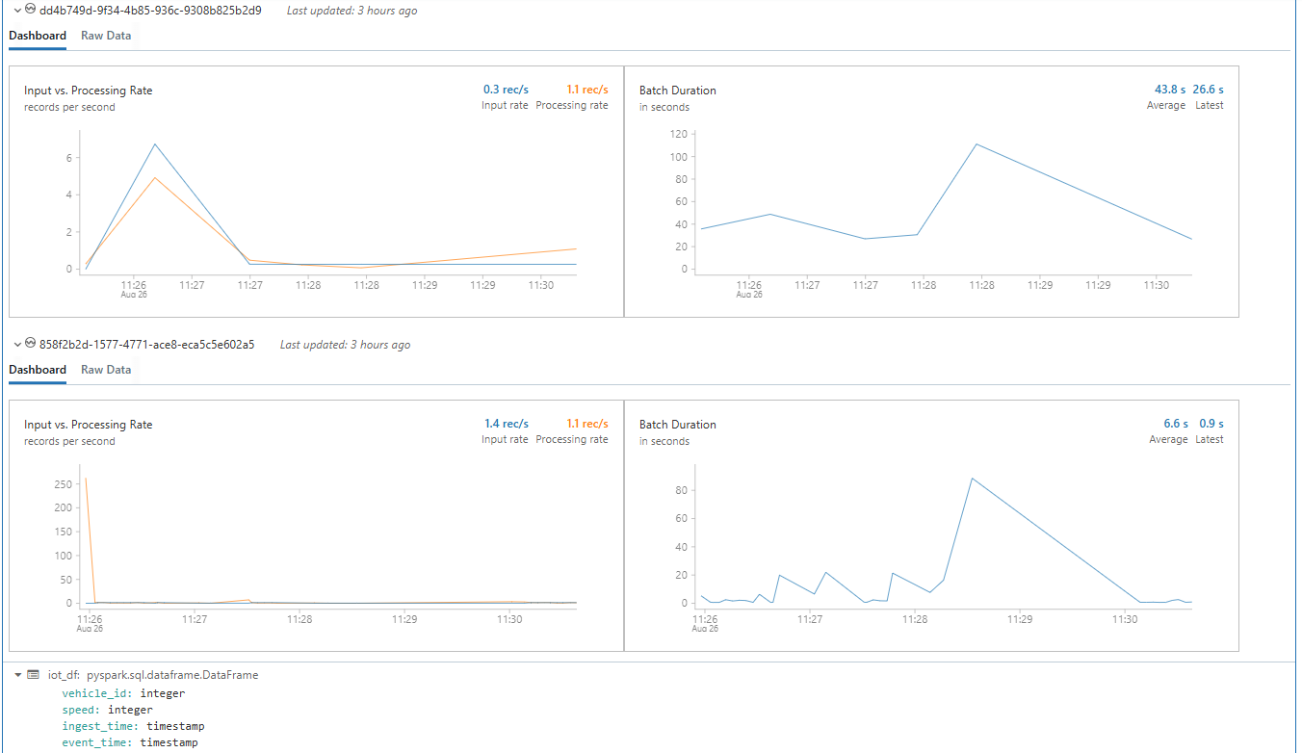
Bronze: raw ingestion (PySpark)
Read Event Hubs stream as raw body (STRING)
Keep schema loose (strings) to avoid pipeline failures on schema drift
Persist to Delta Bronze path with checkpointing

Slide 12
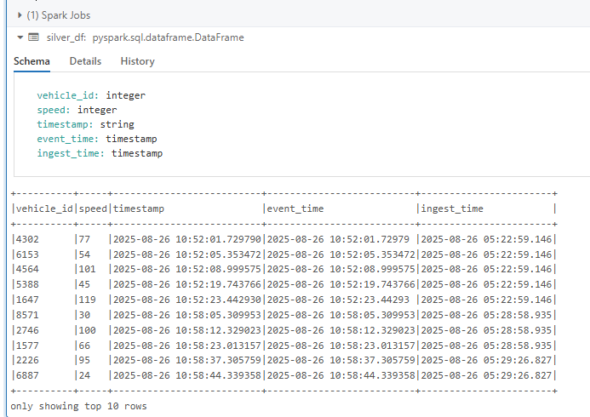
Silver: cleaning & schema enforcement
Parse and enforce schema (INT, TIMESTAMP)
Add lineage fields (ingest_time) and drop malformed rows to error path
Store cleaned data to Silver Delta path

Slide 13
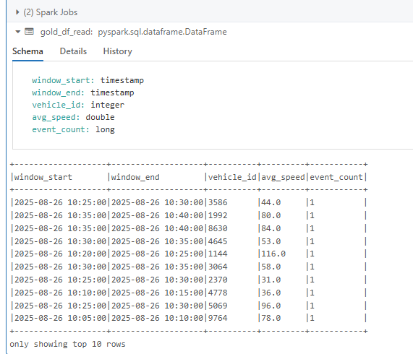
Gold: windowed aggregations (analytics)
Use watermarking and time windows (e.g., 5-minute)
Compute avg_speed & event_count per vehicle per window
Write results to Gold Delta for queries & dashboards

Slide 14
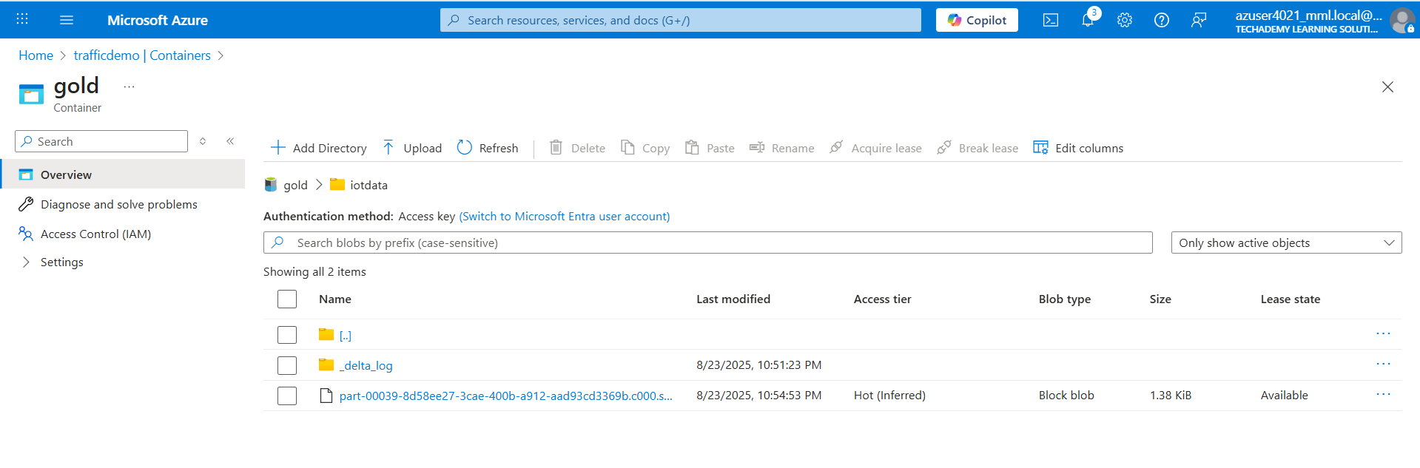
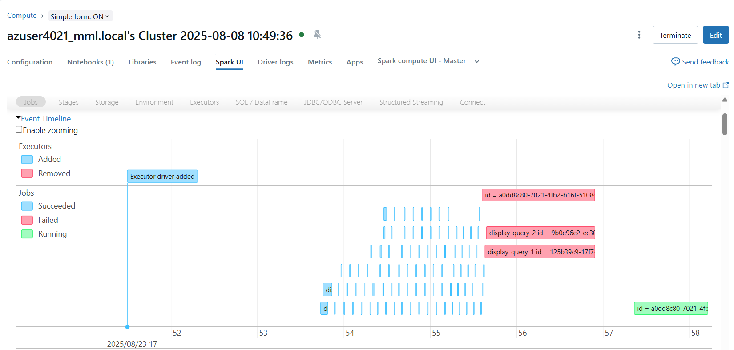
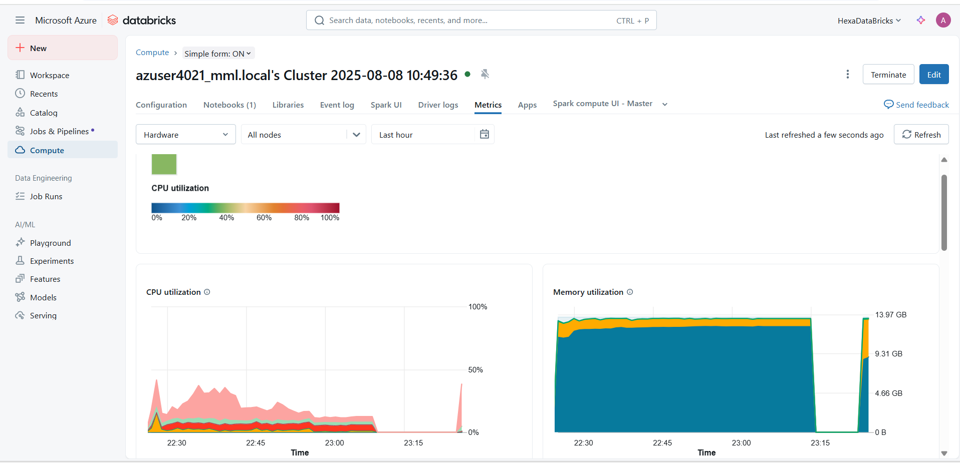
Successful output generated

Slide 15
Optimization Strategies
Data Pipeline Efficiency
Use Delta Lake for incremental updates & schema evolution.
Optimize streaming jobs with window functions & watermarks.
Resource Optimization
Auto-scaling clusters in Databricks.
Caching & partitioning frequently used datasets.
Real-Time Performance
Use Event Hub batch optimization (reduce latency).
Apply filtering & aggregation at ingestion to minimize downstream load.
Monitoring & Alerts
Implement metrics dashboards (traffic flow, congestion hotspots).
Set real-time anomaly detection alerts for accidents/overloads.

Slide 16
Conclusion
End-to-end streaming pipeline implemented (Event Hub → Databricks → Delta)
Bronze/Silver/Gold architecture ensures data quality & reusability
Real-time metrics (avg speed, density) available for dashboards
Extensible design for ML & anomaly detection pipelines

Slide 17
Future enhancements
Add ML: congestion prediction & anomaly detection
Geo-enrichment: attach road/zone metadata to vehicle events
Edge filtering: reduce event volume before ingestion
Integration with traffic control systems (alerts, light timing)

Slide 18
Thank you….

